Slide 1
Digestion of carbohydrate
Dr. DEEPA G.S
Assistant Professor
Dept. of Physiology and Biochemistry

Slide 2
Hydrolysis of Carbohydrates:
Almost all the carbohydrates of the diet are either
large polysaccharides or disaccharides, which are combinations of monosaccharides by condensation.
This means that a hydrogen ion (H+) has been removed from one of the monosaccharides, and a hydroxyl ion(-OH) has been removed from the next one.
The two monosaccharides then combine with each other at these sites of removal, and the hydrogen and hydroxyl ions combine to form water (H2O).

Slide 3
When carbohydrates are digested, the above process is reversed
This process, called hydrolysis, is the following
R”-R’ +H2O ----- R”OH+R’H
Three major sources of carbohydrates exist in the normal human diet.
They are sucrose, which is the disaccharide known popularly
as cane sugar
lactose, which is a disaccharide found in milk
starches, which are large polysaccharides present in almost all non animal foods, particularly in potatoes and the different types of grains

Slide 4
Other carbohydrates ingested to a slight extent are amylose,glycogen, alcohol, lactic acid, pyruvic acid, pectins, dextrin and minor quantities of carbohydrate derivatives in meats.
The diet also contains a large amount of cellulose,
which is a carbohydrate

Slide 5
Digestion of Carbohydrates in the Mouth and Stomach:
food is chewed, it is mixed with saliva, which contains
the digestive enzyme ptyalin (an a-amylase) secreted
mainly by the parotid glands.
This enzyme hydrolyzes starch into the disaccharide maltose and other small polymers of glucose that contain three to nine glucose molecules
not more than 5 per cent of all the starches will have become hydrolyzed by the time the food is swallowed.

Slide 6
Activity of the salivary amylase is blocked by acid of the gastric secretions
Before food and its accompanying saliva completely mixed with the gastric, as much as 30 to 40 per cent of the starches hydrolyzed mainly to form maltose

Slide 7
Digestion of Carbohydrates in the Small Intestine
Digestion by Pancreatic Amylase.
Several times powerful.
Therefore, within 15 to 30 minutes after the chyme empties from the stomach into the duodenum and mixes with pancreatic juice, virtually all the carbohydrates will have become digested.
In general, the carbohydrates are almost totally converted into maltose and/or other very small glucose polymers before passing beyond the duodenum or
upper jejunum.

Slide 8
Hydrolysis of Disaccharides and Small Glucose Polymers into Monosaccharides by Intestinal Epithelial Enzymes:
The enterocytes lining the villi of the small intestine
contain four enzymes (lactase, sucrase, maltase, and
a-dextrinase)
They are capable of splitting the disaccharides lactose, sucrose, and maltose, plus other small glucose polymers, into their constituent monosaccharides.

Slide 9
Lactose splits into a molecule of galactose and a molecule of glucose.
Sucrose splits into a molecule of fructose and a molecule of glucose.
Maltose and other small glucose polymers all split into multiple molecules of glucose.
Thus, the final products of carbohydrate digestion are all monosaccharides.
They are all water soluble and are absorbed immediately into the portal blood.

Slide 10
glucose represents more than 80 per cent of the final product of carbohydrate digestion
galactose and fructose each seldom more than 10 per cent.

Slide 11
Boiled starch
Soluble starch
erythrodextrin
maltose

Slide 12
Erythrodextrin
Maltose,maltotriose+isomaltose
Achrodextrin
Maltose,isomaltose

Slide 13
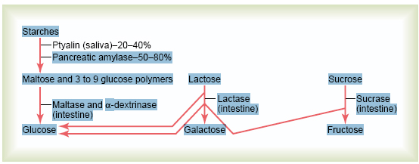

Slide 14
Absorption

Slide 15
Absorption
Process by which end products of digestion pass through the intestinal epithelium and enter the blood stream
Stomach :absorbs very little food
eg: water, alcohol, saline, glucose, easily diffusible drugs
Small intestine: Chief site for absorption
Upper part: Secretion
Lower part: Absorption

Slide 16
Absorbing units: Villi
No: About 5,000,000
Total absorbing area: 10 sq.mts
End products of carbohydrates and protein: Absorbed by vascular capillaries in the villi and drained to portal system
fats: Lacteals of villi to lymphatics
Large intestine: Mainly absorbs water

Slide 17
Human diet contains three types of carbohydrates:
1. Polysaccharides:
Starch (Glycogen, Amylose and Amylopectin)
2. Disaccharides
Sucrose- Glucose & fructose (cane sugar)
Lactose-Glucose & Galactose (sugar in milk)

Slide 18
Mono saccharides:
Mostly seen in human diet are
Glucose
Fructose
Other carbohydrates in the diet include
Alcohol
Lactic acid
Pyruvic acid
Pectins
Dextrins
Carbohydrates in meat
Cellulose in diet cannot be considered as food as it is undigestable

Slide 19
Absorption of carbohydrates:
Absorbed in the form of monosaccharides viz.glucose,galactose and fructose.
80% of monosacharide absorbed as glucose
20% as galactose and fructose

Slide 20
Absorption of Glucose:
Transported by Sodium co transport
Two stages:
First: from baso lateral membranes of intestinal epithelial cells
Active transport of sodium
Para cellular spaces
Depletion of sodium inside the cells

Slide 21
Second stage:
Intestinal lumen ( increased Na)
Na along with GL (Na co-transport )
epithelial cells (decreased Na)
Facilitated diffusion
Glucose to Portal vein Na laterally to inter cellular space and to blood
Site of absorption:Jejunum mainly

Slide 22
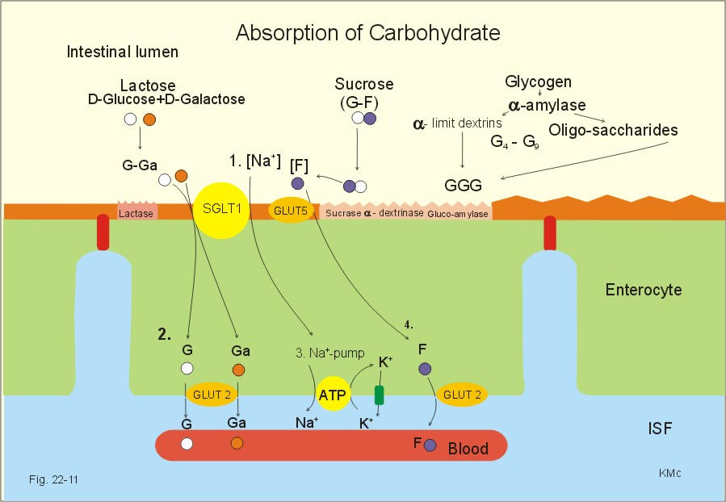

Slide 23
Absorption of galactose :
Same as that of glucose
Absorption of Fructose:
By means of facilitated diffusion into blood
Most of them are converted into glucose and absorbed

Slide 24
Absorption of protein
Absorbed in the form of aminoacids
Levo amino acids by means of sodium co-transport
Dextro amino acids by means of facilitated diffusion
Mainly in jejunum

Slide 25
LIPIDS
Lipids in diet:
1) Mostly in the form of Neutral fats, or Triglycerides (glycerol + free fatty acids)
2) Cholesterol
3) Cholesterol esters
4)Phospholipids
5)Fat soluble vitamins

Slide 26
Dietary fats classified into two:
1)Saturated fats
2)Unsaturated fats
a) monounsaturated fats
b)polyunsaturated fats
c) trans fats

Slide 27
Absporption of Fat:
Role of micelles in fat absorption:
Micelles move down to the mucosal surface
Lipid portion enters the cell by passive difusion
Bile salts left behind moves back into the chyme and take more fatty acids, monoglycerides and transport them into brush border (Ferrying function)

Slide 28
Micelles:
small spherical,cylindrical globules 3-6nm in diameter
Composed of 20-40 bile salt molecules
Consists of a polar group which is hydrophilic and a sterol nucleus which is hydrophobic

Slide 29
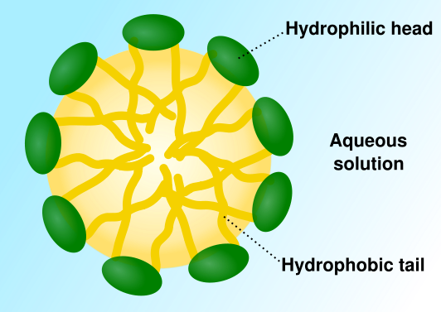

Slide 30
Bile salt micelle Mixed micelle Intestinalmucosa
Cholestrol
Phospolipid ` Monoglyceride
freefattyacids

Slide 31
triglycerides
Lipases
Glycerol and fatty acids
( long chain and short chain )

Slide 32
Short chain fatty acids Long chain fatty acids
Diffusion
Portal blood Resynthesis to triglycerides
( In SER contain enzyme and co-factors)

Slide 33
Glycerol
Glycerol with free fatty acid Glycerol
diffusion
Portal blood L. glycerophosphate
( used in resynthesis of triglycerides and phospolipids in cell)

Slide 34
Cholestrol esters
Esterase
Free cholestrol
Reesterification in the cells

Slide 35
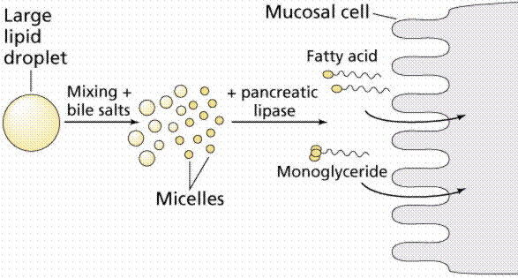

Slide 36
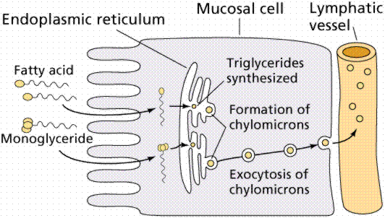

Slide 37
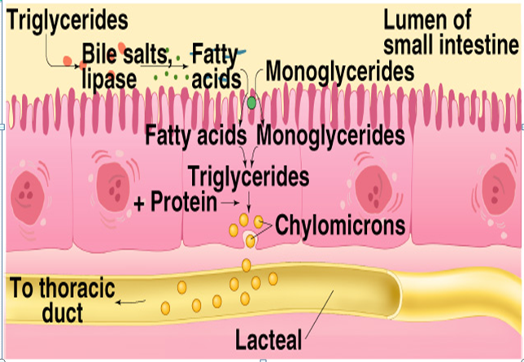

Slide 38
Function of chylomicrons and transport into Lymph
CHYLOMICRON:
Triglycerides, absorbed phospolipids,Cholestrol
cholestrol esters , free fatty acids with 14 or more than 14
carbon atoms and fat soluble vtamin combine with
protein in cisternae of ER to form chylomicrons which
are large lipoprotein molecule 0.1 -0.5micro meter.

Slide 39
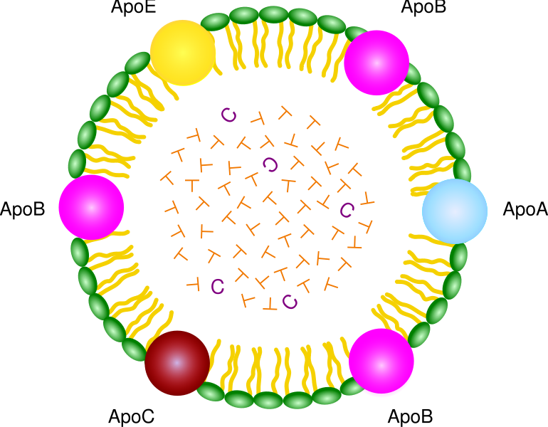

Slide 40
Chylomicron
Lacteal
Thoracic duct
Venous blood

Slide 41
Storage of lipids: Stored in liver and adipose tissue
When Chylomicron enters in capillaries of adipose tissue-: Triglycerides
Lipoprotein lipase in capillary endothelium
FFA Glycerol
Triglycerides in the fat cells and stored
Hydrolysis
FFA Glycerol( when tissues need energy)

Slide 42
Cholestrol and phospolipid released in the blood combine with protein to form lipoproteins
Absorption of water :
Digestive juices – about 7 litres of water
Ingested fluid and food – 1-1.5 litres of water
1 – 1.5 litres of fluid enters colon
Therefore about 7.5 litres of water reabsorbed in SI
Absorbed mainly by osmosis followed by solute absorption.

Slide 43
Absorption of Ions
Active Transport of Sodium
Twenty to 30 grams of sodium are secreted in the intestinal secretions each day.
In addition, the average person eats 5 to 8 grams of sodium each day.
Therefore, to prevent net loss of sodium into the feces, the intestines must absorb 25 to 35 grams of sodium each day.

Slide 44
Process:
Absorption mainly in jejunum
From lumen to cell – Na .co transport
From cell to intercellular space - Na.K. ATPase pump.
In ileum by Na.H ⁺counter transport
Bulk flow
Osmosis of the Water.
The next step in the transport process is osmosis of
water into the paracellular spaces.
Aldosterone Greatly Enhances Sodium Absorption

Slide 45
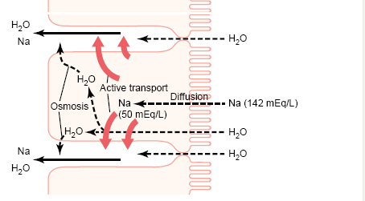

Slide 46
Absorption of Chloride Ions in the Duodenum and Jejunum.
Upper part of the small intestine,
Mainly by diffusion as consequence with sodium in order to maintain electrical neutrality.
Hco3.Cl counter transport
Absorption of Bicarbonate Ions in the Duodenum and Jejunum
In jejunum-Active absorption
In ileum – secretion in exchange for cl⁻

Slide 47
Absorption of K : by diffusion
Absorption of Other Ions
Calcium ions are actively absorbed into the blood
especially from the duodenum
Factors controlling calcium absorption
parathyroid hormone
vitamin D.
Parathyroid hormone activates vitamin D and this in turn greatly enhances calcium absorption.

Slide 48
Iron
In the diet is in the form of ferric(not easily absorbed)
So reduced to Ferrous
Brush border contains mobil ferrin which binds to iron and helps to enter into the cell
In the cell – Fe binds to iron binding protein called apoferritin
Absorption mainly in duodenum and proximal jejunum
Vit c increases absorption

Slide 49
Absorption of vitamins:
A,D,E and k absorbed as same as fats
Most B group vit by passive diffusion in jejunum
B12 in ileum ( IF is essential)
Vit c by passive diffusion in proximal part mainly

